Slide 1

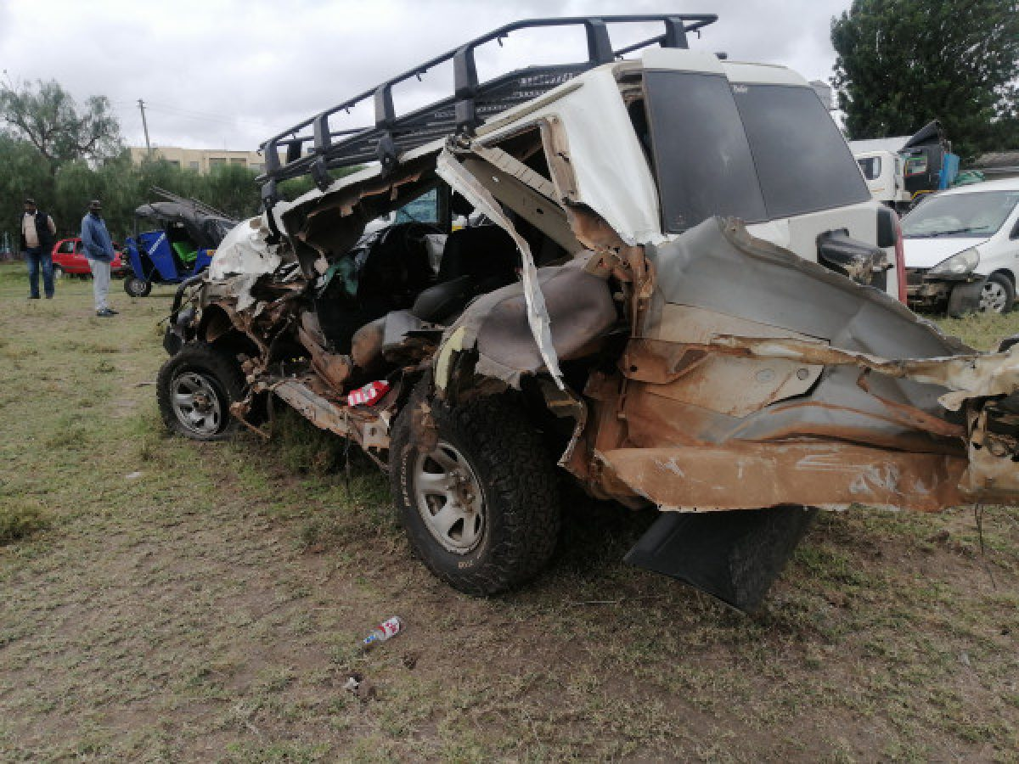
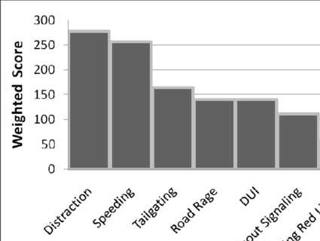
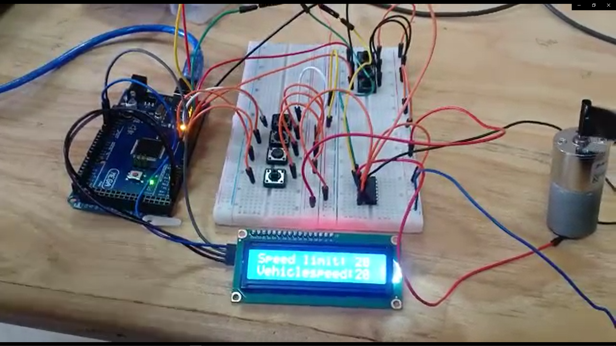

DYNAMIC SPEED GOVERNOR FOR HOTSPOT AND SPEED RATED AREAS
ABSTRACT
Supervisor: Dr. Titus Mulembo
PROBLEM STATEMENT
. It is unfortunate that hundreds lose their lives per year due to road accidents. Studies have shown that one of the leading causes of road accidents is over-speeding
OBJECTIVES
With this project we hope to flatten the curve when it come to road accidents tied to speeding.
INTRODUCTION
Our project involves a speed governing mechanism for vehicles which limits their speed depending on speed limit of the particular zone within which the vehicle is in. Unlike the static Speed governor, a dynamic speed governor is more effective since different zones have different speed limits.
MECHANISM
RECEIVER IN THE CAR GETS SPEED LIMIT FROM TRANSMITTER
VEHICLE SPEED IS FED INTO THE MICRO-CONTROLLER
MICRO-CONTROLLER COMPARES THE TWO SPEEDS
The project employs the use of simple yet effective components and concepts. The transmitter is mounted on or along the road and is always transmitting. Receivers mounted in vehicles detect the speed limit. All this while, the LCD is displaying the Vehicle’s speed and the detected speed limit. An alert is issued to the driver using a buzzer, and finally the vehicle is slowed down to the zone’s speed limit
VEHICLE SPEED IS TRIMMED TO THE SPEED LIMIT
IF VEHICLE SPEED IS GREATER THAN SPEED LIMIT...
RESULTS
Our project was successful, and what we came up with was a working prototype displaying the dynamic properties of the speed governor. A recent study by FMCSA showed that vehicles with speed limitters had a 50% lower crash rate than those without. And those statistics only involved static speed governor. A dynamic speed governor would highly likely achieve a higher figure
Installation of speed governors in vehicles would most definitely make the roads safer overall.
1
Considering the simplicity of the project, it is possible for it to be implemented by the state or taken up by car manufacturers.
2
CONCLUSION

